Slide 1

UML
Nick Thomas

Slide 2
Class Diagrams

Slide 3
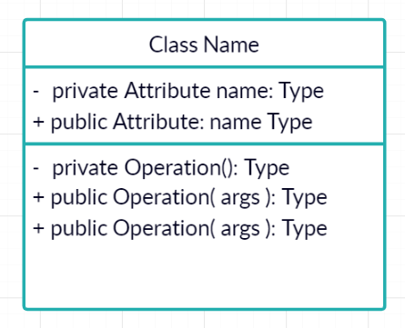
Defining a Class

Slide 4
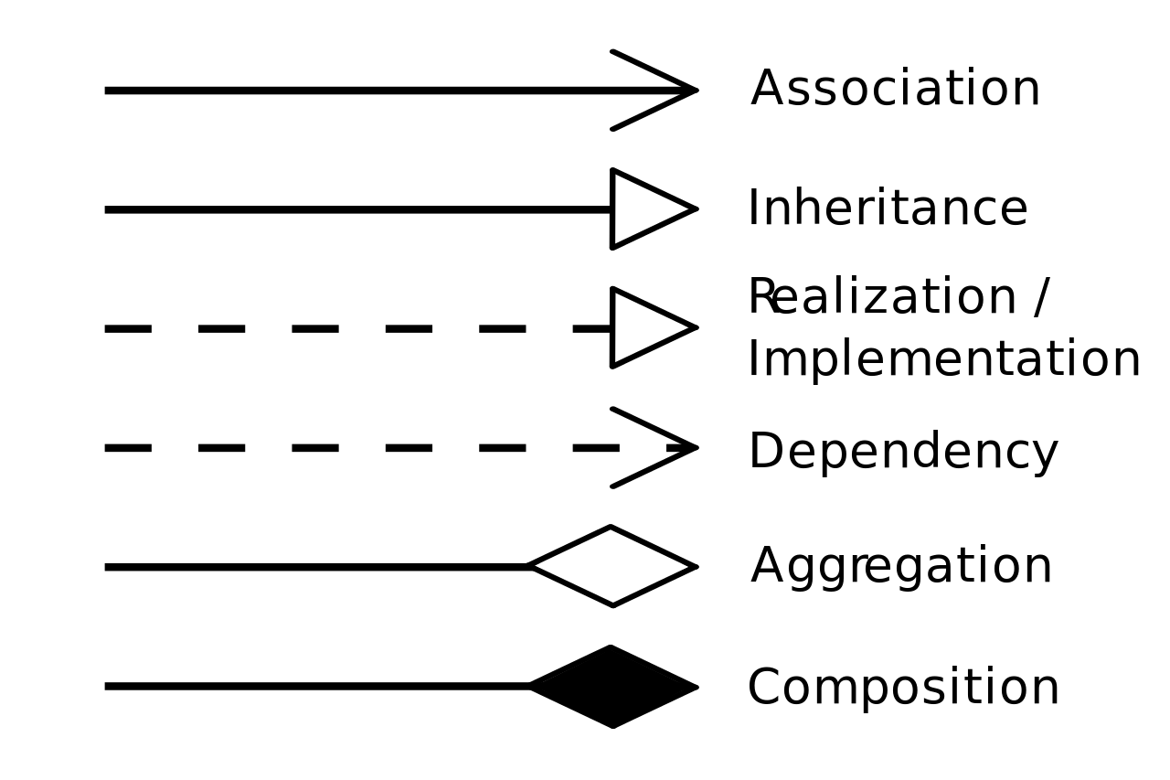

Slide 5
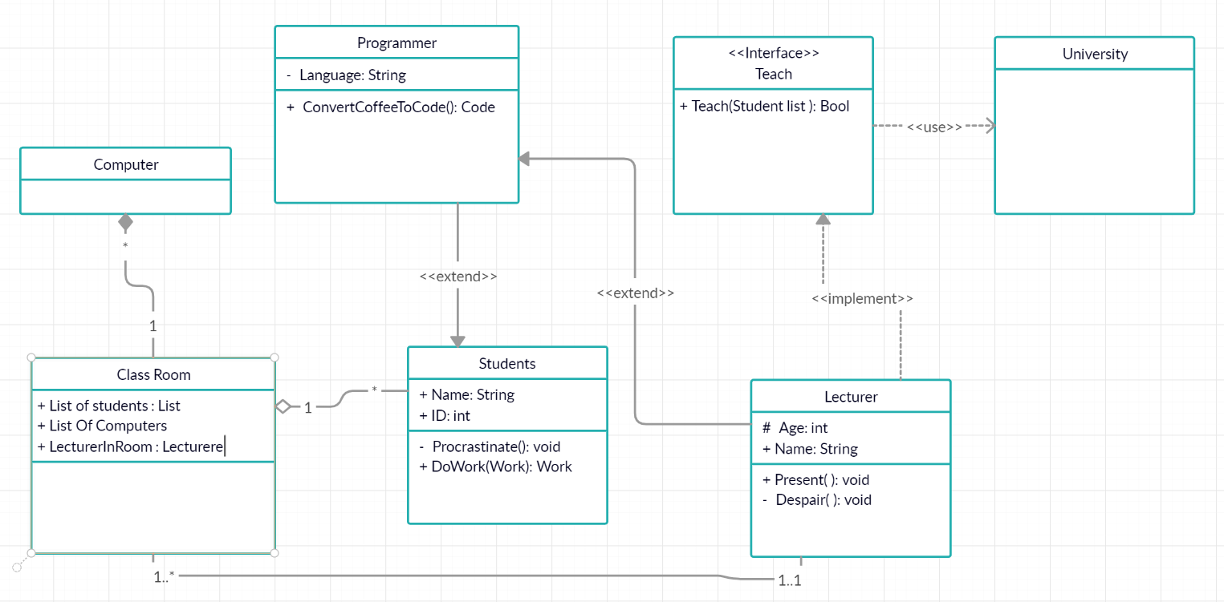
Notes:
Extends = inheritance
Implements = implementing interfaces
Use = dependent on external system
Association = a link between two objects, neither requires the other but they are ASSOCIATED together.
Aggregation = Collects objects together but when the collection is destroyed, the other objects are not destroyed.
Composition = collects objects together but when the collection is destroyed the other objects ARE destroyed.

Slide 6
Use Case Diagrams

Slide 7
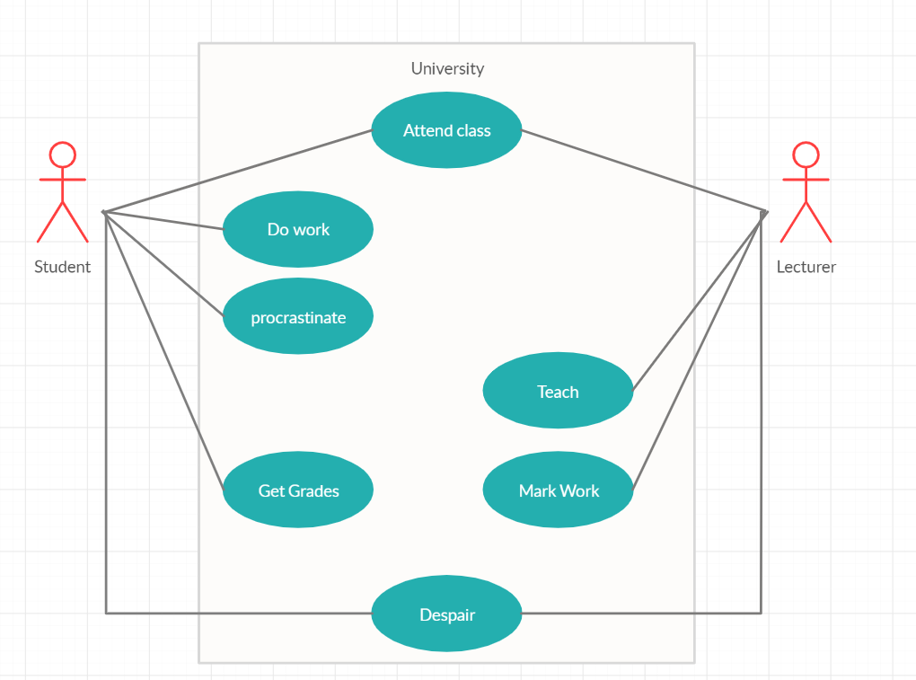

Slide 8
Use case Diagrams

Slide 9
